Slide 1
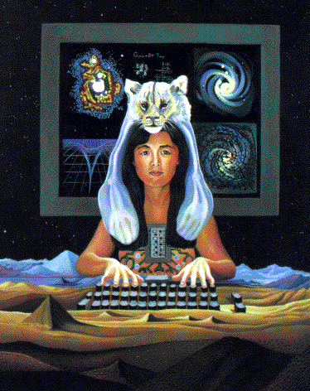
“In the Belly of the Monster”: Feminist Perspectives on Science and Technology
course description
905.053
2 SE
WM2
5 ECTS
summer term 2016
instructor: Josef Barla
email: josef.barla@univie.ac.at
Feminist and queer inquires into the nature of scientific knowledge production have demon-strated that science is a powerful source of images and imaginations about our world. In doing so, a hegemonial form of scientific knowledge production has been identified as the “god trick” (Haraway) of seeing everything from nowhere. In a similar way, technology has been theorized as “masculine culture” (Wajcman) and therefore as always political. “We're inside of what we make, and it's inside of us. We're living in a world of connections — and it matters which ones get made and unmade”, Donna Haraway reminds us.
In this course, we will investigate the complex relationships between science, technology, and gender in historical and contemporary contexts. We will discuss key concepts and theoretical approaches of feminist science and technology studies by examining how feminist scholars have problematized the ways in which difference according to sex, gender, race, dis/ability, and species is embedded into and at the same time also produced by science and technology. Moreover, we will engage with current feminist and queer approaches and ask how they provide different ways of understanding science and technology.
Is science only about objective facts and the discovery of truth? And if not, how can we then talk about facts, truth, and objectivity without running the risk of falling into relativism? How do images and imaginations about sex, gender, race, and dis/ability shape science and technology, and how are they, in turn, shaped by science and technology? How are bodies and identities—and with them also politics—enacted through techno-scientific practices and technologies?
Exploring different approaches on the question of how technologies shape and simultaneously are shaped by social, economic, political, and other factors, and how values and power relations are embedded into technical systems and technologies, we will learn what science and technology have to do with issues of social justice, equality, and democracy.

Slide 2
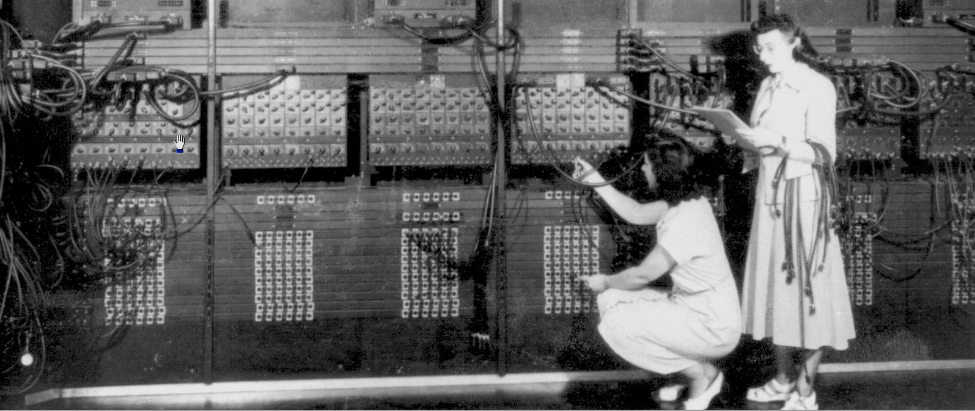
methods and goals
This course will be run as a reading and discussion intensive seminar. Preparation for class discussion by careful reading of the week’s literature is required. Through a close reading of the literature, discussions, and group work, participants who take this course will:
get introduced into key theories, concepts, and approaches in feminist science and technology studies
be able to apply a variety of methods of critical thinking and philosophical reflection to key theories and phenomena in science and technology
develop a broad understanding of the multilayered and historical contingent relationship of science, technology, knowledge, power, and gender
discuss different takes on and develop own thoughts about how assumptions about gender as well as gender identities shape and are shaped by science and technology
requirements
The classroom should function as a forum for intellectual exchange wherein participants have read the material, critically reflected upon the content, and are willing to engage in discussion with fellow scholars. Since we will learn together as a group, each participant is expected to a) attend the classes and participate in ongoing discussions, b) present the key arguments of a paper (~30 min.) and lead the class discussion on that paper, c) prepare a short (3 pages) critical commentary as well as 2-3 discussion questions on the presented paper, and d) write a research paper (15 pages) on a topic of your choice OR three short essays (each 5 pages) critically analyzing and discussing selected papers to be read for the course.
grading
Attendance and participation (including short commentaries, discussion leading, and group work): 20%
Co-chairing and presentation of a paper: 25%
Short critical commentary (3 pages): 15%
Final term paper (15 pages) OR three short essays (each 5 pages): 40%
All requirements must be met in order to pass the course.
Gloria Ruth Gordon and Ester Gersto programming the Electronic Numerical Integrator And Computer (ENIAC), around 1946

Slide 3
class schedule and readings
Week 1
Introduction
Week 2
Gender, Science, and Nature I: The Field
Readings:
Keller, Evelyn Fox. 2001. “Gender and Science: An Update,” In Women, Science, and Technology: A
Reader in Feminist Science Studies. Eds. Mary Wyer et al. New York and London: Routledge. 128–137.
Subramaniam, Banu. 2014. Ghost Stories of Darwin. The Science of Variation and the Politics of
Diversity. Urbana, Chicago, and Springfield: The University of Illinois Press. Chapter: “The
Emperor’s New Clothes. Revisiting the Question of Women in the Sciences”, 200–222.
Week 3
Gender, Science, and Nature II: The Body
Readings:
Oudshoorn, Nelly. 2000. “The Birth of Sex Hormones.” In Feminism and the Body. Ed. Londa
Schiebinger. Oxford: Oxford University Press, 87 – 117.
Schiebinger, Londa. 2000. “Skeletons in the Closet: The First Illustrations of the Female Skeleton in
Eighteenth Century Anatomy.” In Feminism and the Body. Ed. Londa Schiebinger. Oxford: Oxford
University Press, 25 – 57.
Week 4
Objectivity I: Feminist Empiricism and Standpoint Theory
Readings:
Harding, Sandra. 1986. Science Question in Feminism. Ithaca: Cornell University Press. Chapter: “From
Feminist Empiricism to Feminist Standpoint Epistemologies”, 136–162.
Longino, Helen. 1996. “Subjects, Power, and Knowledge: Description and Prescription in Feminist
Philosophies of Science.” In Feminism and Science. Eds. Evelyn Fox Keller and Helen E. Longino.
Oxford: Oxford University Press, 264–279.
Week 5
Objectivity II: Situated Knowledges and Strong Objectivity
Readings:
Haraway, Donna. 1991. Simians, Cyborgs and Women. The Reinvention of Nature. New York and
London: Routledge. Chapter: “Situated Knowledges: The Science Question in Feminism and the
Privilege of Partial Perspective”, 183–201.
Harding, Sandra. 1993. “Rethinking Standpoint Epistemology: What is ‘Strong Objectivity’?” In Feminist
Epistemologies. Ed. Linda Alcoff and Elizabeth Potter. London and New York: Routledge, 49–82.
Week 6
The Politics of Technology
Readings:
Berg, Anne-Jorunn, and Merete Lie. 1995. “Feminism and Constructivism: Do Artifacts Have Gender?”
Science, Technology, and Human Values, 20 (3): 332–351.
Wajcman, Judy. 2007. “From Women and Technology to Gendered Technoscience.” Information,
Communication and Society, 10 (3): 287–298.

Slide 4
Week 7
Engineering and Computers
Readings:
Abbate, Janet. 2012. Recoding Gender: Women’s Changing Participation in Computing. Cambridge,
Mass.: MIT Press, Chapters: “Introduction: Rediscovering Women’s History in Computing” and
“Breaking Codes and Finding Trajectories: Women at the Dawn of the Digital Age”, 1–38.
Chun, Wendy. 2005. “On Software, Or the Persistence of Visual Knowledge.” Grey Room, 18
(Winter 2005): 26–51.
Week 8
Technoscience
Readings:
Haraway, Donna. 1992. “The Promises of Monsters: A Regenerative Politics for Inappropriate/d Others”.
In Cultural Studies. Eds. Lawrence Grossberg, Cary Nelson, and Paula Treichler. New York and
London: Routledge, 295–337.
Week 9
Biopolitics: Medicine and Reproduction
Readings:
Murphy, Michel. 2012. Seizing the Means of Reproduction. Entanglements of Feminism, Health, and
Technoscience. Durham and London: Duke University Press. Chapter: “Introduction: Feminism in/as
Biopolitics”, 1–24.
Clarke, Adele. 1995. “Modernity, Postmodernity and Human Reproductive Processes c1890-1990, or
'Mommy, Where do Cyborgs Come From Anyway?’” In The Cyborg Handbook. Ed. Chris Hables Gray.
New York: Routledge, 139–156.
Tuana, Nancy. 2006. “The Speculum of Ignorance: The Women’s Health Movement and Epistemologies
of Ignorance.” Hypatia, 21 (3): 1–19.
Week 10
Postcolonial Perspectives on Science and Technology
Readings:
Subramaniam, Banu. 2009. “Moored Metamorphoses: A Retrospective Essay on Feminist Science
Studies.” Signs, 34 (4): 951–980.
TallBear, Kim and Jenny Reardon. 2012. “‘Your DNA is Our History.’ Genomics, Anthropology, and the
Construction of Whiteness as Property.” Current Anthropology, 53 (S12): 233–245.
Week 11
Feminist Science (and) Fiction
Readings:
Haraway, Donna. 2013. “SF: Science Fiction, Speculative Fabulation, StringFigures, So Far.” ada – A
Journal of Gender, New Media, and Technology, 3: <http://adanewmedia.org/2013/11/issue3-
haraway/>.
Merrick, Helen. 2010. “Science Stories, Life Stories: Engaging the Sciences Through Feminist Science
Fiction”, Women’s Studies International Forum, 33: 141–148.
Russ, Joana. 1995. To Write Like a Woman. Essays in Feminism and Science Fiction. Bloomington and
Indianapolis: Indiana University Press. Chapter: “What Can a Heroine Do? Or Why Women Can’t
Write”, 79–93.

Slide 5
Week 12
Posthumanisms and the Nonhuman
Readings:
Åsberg, Cecilia, Redi Koobak, and Ericka Johnson. 2011. “Beyond the Humanist Imagination.” NORA –
Nordic Journal of Feminist and Gender Research, 19 (4): 218–230.
Braidotti, Rosi. 2013. The Posthuman. Cambridge and Malden: Polity. Chapter: “Introduction”, 1–12.
Haraway, Donna. 2008. When Species Meet. Minneapolis and London: University of Minnesota Press.
Chapter: “Crittercam: Compounding Eyes in Naturecultures”, 249–263.
Week 13
Race and Technology
Readings:
Chun, Wendy. 2009. “Introduction: Race and/as Technology; or How to Do Things to Race.” Camera
Obscura, 70 (24): 7–34.
Nakamura, Lisa, and Peter A. Chow-White. 2012. “Introduction—Race and Digital Technology: Code,
the Color Line, and the Information Society.” In Race After the Internet. eds. Lisa Nakamura and Peter
A. Chow-White. New York and London: Routledge, 1–18.
Week 14
Course Wrap-Up and Reflection
Final remarks and discussion.

